Slide 1
Book recommender system
Andrea Francis

Slide 2
Problem statement
In 2001, the Book Crossings website released a dataset to the public that included over 1 million ratings (both user-given and implicit ratings).
Business Problem:
In order to continue growing the business, there is a need to increase user engagement and overall satisfaction
Solution:
Build a personalized recommender system that provides smart recommendations based on the books the user has rated previously
Make use of the package ‘Surprise’ as a shortcut for recommendation algorithm
https://github.com/NicolasHug/Surprise

Slide 3
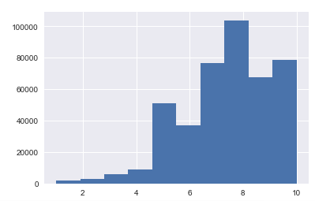
datasets
User Given Ratings Frequency
3 Data sets included
Books (271,379 records)
Users (278,858 records)
Ratings (1,149,780 records)
Fields Included
ISBN | User Location
Publisher | User Age
Title | Rating (Implicit)
Author | Rating (1-10)
Book Cover URL | User ID
Avg
7.63
Ratings
For a simple recommender system, the only fields needed are a User ID, Item ID (ISBN) and the Rating
Due to processing power limitations, a random sample of the Ratings dataset was used (35%)
Average Rating | 7.63
Baseline RMSE (using Avg. Rating) | 1.844

Slide 4

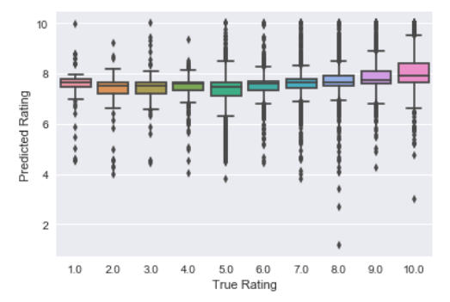

The model
Using the similarity measure, we identify the k items rated by j, which are most similar to i.
The predicted rating is taken as a weighted average of the ratings of neighboring items, while adjusting for user and item effects through the baseline estimates
Collaborative Filtering Method
Item based collaborative filtering predicts the rating that would be given for Item i, by User j by looking for for other items that are similar to item i, that user j may have already rated.
Similarities are calculated between vectors of Book Ratings where there area shared users between vectors (i.e., Book A is rated by Users 1,3,5 and Book B is rated by Users 2,3,5,8,9 ) then a similarity could be calculated for Users 3 and 5.
Cosine Similarity
Biased RMSE (from Cross-Validation) | 1.722
Unbiased RMSE (from hold out Test group) | 1.737
Difference from Baseline | - 0.107
Predictions Distribution

Slide 5
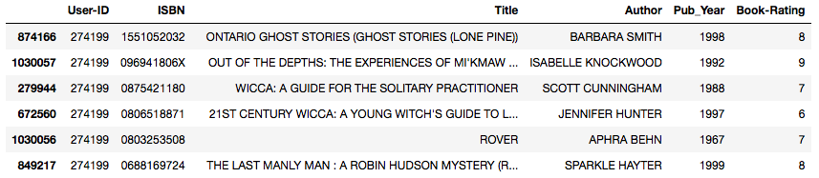
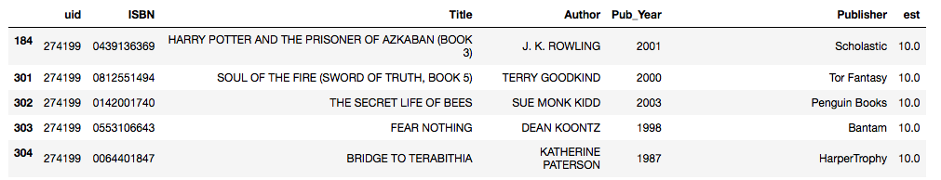
Model Output
Previously Rated Books
Suggested Books User Has Not Yet Rated

Slide 6
Areas for improvement / next steps
GET MORE PROCESSING POWER – This model was limited by the processing power available. If greater processing power was used, full dataset could be used to train/test the model, which should provide greater accuracy
FURTHER DATA CLEANING - Combine different ISBNs for the same Title/Author combination
INCORPORATE ADDITIONAL INFORMATION - Make use of Location and Age data to make predictions
Would also require further cleaning of location data (i.e, geo coding)
USE IMPLICIT RATINGS - Make use of implicit rating data (could be separate model or combination)
TRY OTHER APPROACHES I.E., SVM

